Slide 1


Consumer Goods
Ad Hoc Insights
SQL Project

Slide 2

Objectives
Atliq Hardwares (Imaginary company ) is a top-tier computer hardware manufacturer based in India, renowned for its quality products. The company has successfully expanded its operations to multiple international markets. Its global presence reflects a strong commitment to innovation and customer satisfaction.
Management observed a lack of actionable insights to make quick and informed decisions.
Management decides to Expand the data analytics team by hiring junior data analyst.
Tony Sharma, the data analytics director, aimed to hire candidates proficient in both technical and soft skills.
There are 10 ad hoc requests for which the business needs insights.

Slide 3

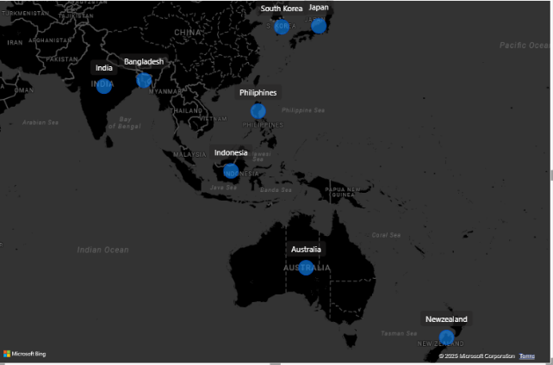
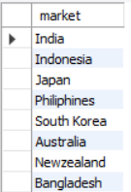
1. Provide the list of markets in which customer "Atliq Exclusive" operates its business in the APAC region.
SQL QUERY
OUTPUT

Slide 4
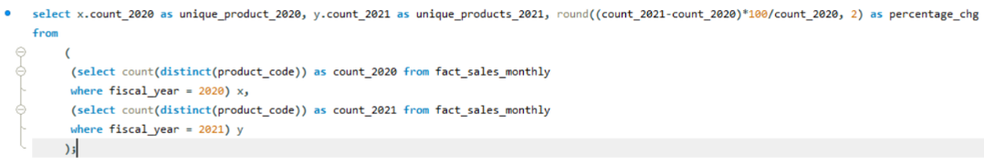
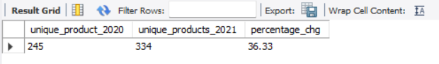
2. What is the percentage of unique product increase in 2021 vs. 2020? The final output
contains these fields:
unique_products_2020 ,unique_products_2021 ,percentage chg.
SQL QUERY
OUTPUT

Slide 5
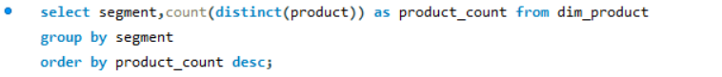
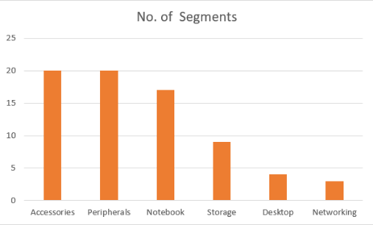
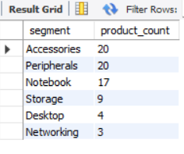
3. Provide a report with all the unique product counts for each segment and
sort them in descending order of product counts. The final output
contains 2 fields: segment, product _count .
SQL QUERY
OUTPUT

Slide 6
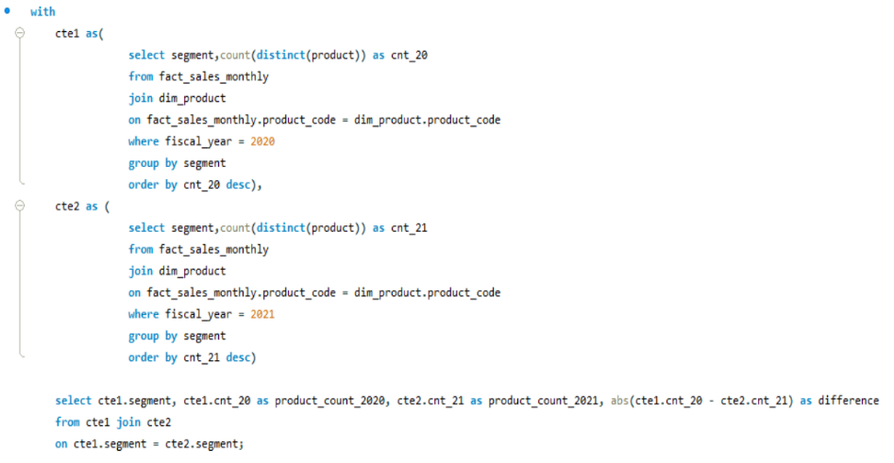
4 .Follow-up: Which segment had the most increase in unique products in 2021
vs 2020? The final output contains these fields:
Segment, product_count_2020, product_count_2021, difference.
SQL QUERY

Slide 7
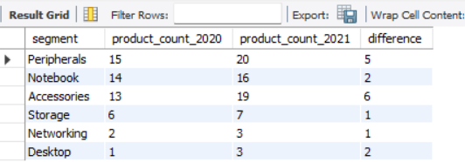
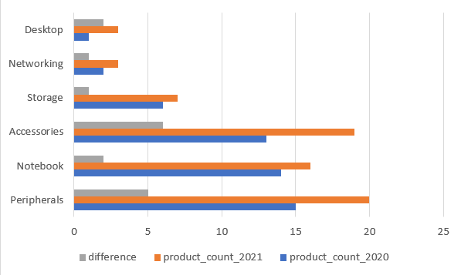
OUTPUT

Slide 8
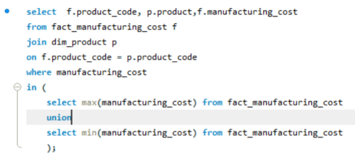
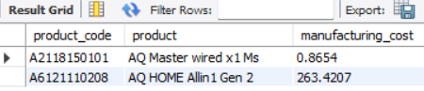
5. Get the products that have the highest and lowest manufacturing costs.
The final output should contain these fields:
product_code ,product, manufacturing_cost .
SQL QUERY
OUTPUT

Slide 9
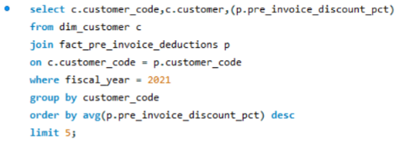
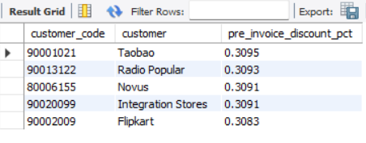
6. Generate a report which contains the top 5 customers who received an
average high pre_invoice_discount_pct for the fiscal year 2021 and in the
Indian market. The final output contains these fields :
customer_code, customer ,average_discount_percentage
SQL QUERY
OUTPUT

Slide 10
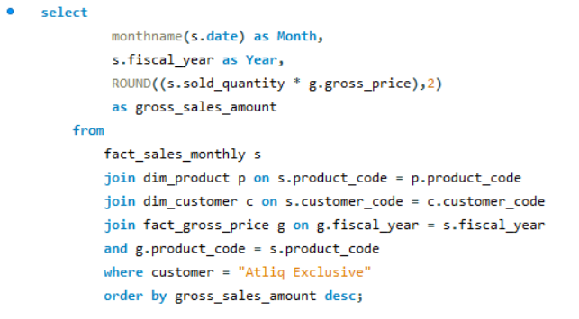
7.Get the complete report of the Gross sales amount for the customer “Atliq
Exclusive” for each month . This analysis helps to get an idea of low and
high-performing months and take strategic decisions. The final report
contains these columns: Month, Year, Gross sales Amount
SQL QUERY

Slide 11
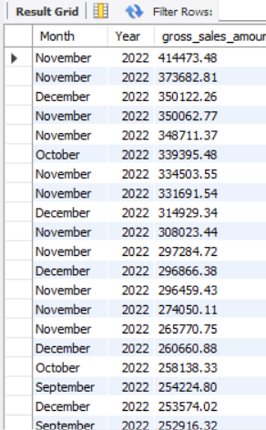
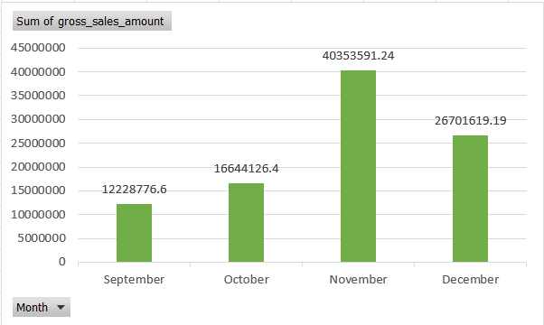
OUTPUT

Slide 12
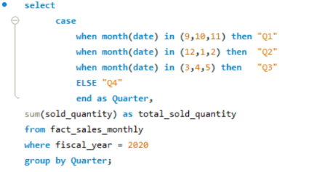
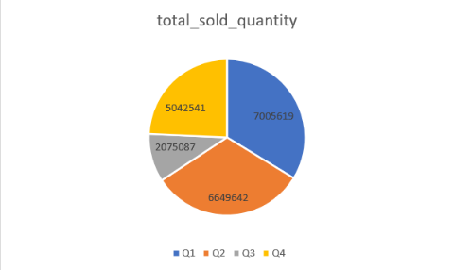
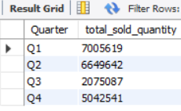
8. In which quarter of 2020, got the maximum total_sold_quantity ?
The final output contains these fields sorted by the total_sold_quantity,
Quarter ,total_sold_quantity.
SQL QUERY
OUTPUT

Slide 13
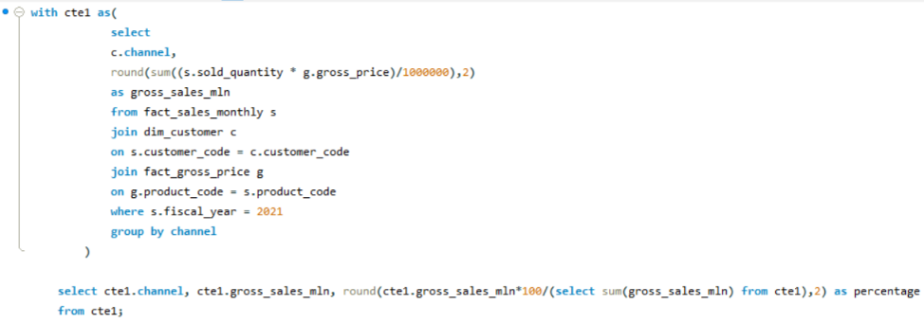
9. Which channel helped to bring more gross sales in the fiscal year 2021 and
the percentage of contribution? The final output contains these fields :
channel ,gross_sales_mln , percentage
SQL QUERY

Slide 14
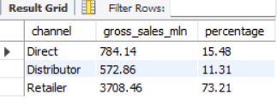
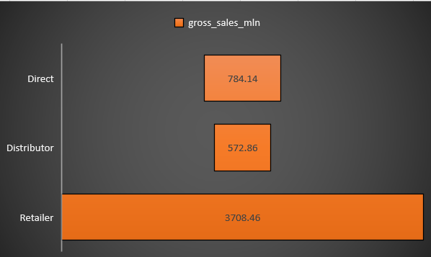
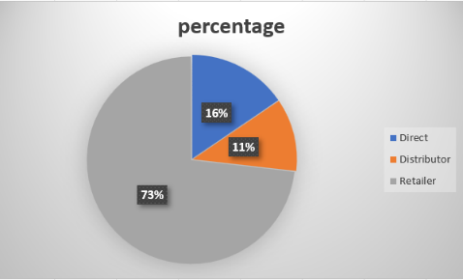
OUTPUT

Slide 15
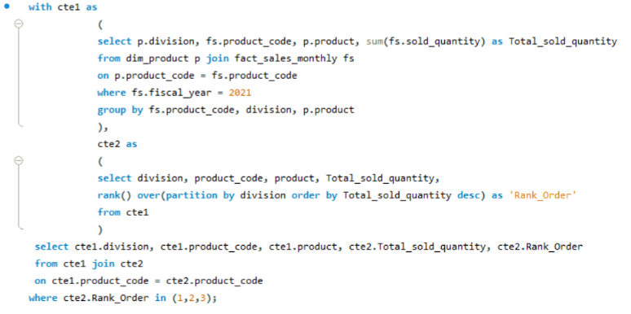
10. Get the Top 3 products in each division that have a high total_sold_quantity in
the fiscal_year 2021? The final output contains these fields:
division , product_code , product, total_sold_quantity , rank_order .
SQL QUERY

Slide 16
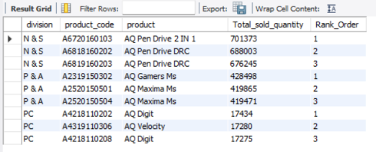
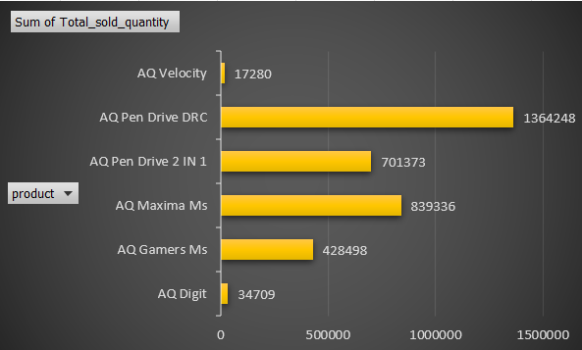
OUTPUT

Slide 17
SUGGESTIONS
Develop budget-friendly options for smaller businesses, schools, and home users in less competitive markets.
Partner with local retailers to increase product penetration in these areas.
Provide businesses with subscription-based hardware solutions (e.g., PCs, servers, or laptops) instead of one-time purchases.
Include regular maintenance, upgrades, and replacements in the subscription fee.
Reward existing customers for referring new customers with discounts or free accessories.
Offer incentives to retailers or distributors who help increase sales volume.
Set up authorized service centers in key cities to provide repair and upgrade services, creating a better post-sale experience.
Use these centers as customer touchpoints for upselling accessories or extended warranties.
Offer back-to-school discounts for students or corporate deals during the fiscal year-end.
Create limited-time bundles (e.g., "Laptop + Mouse + Keyboard" for a discounted price).
Use retargeting ads to bring back customers who viewed products but didn’t purchase.
Redesign packaging to be compact and secure for shipping through online marketplaces.

Slide 18

THANK YOU
SHASHANK GAUTAM

